Slide 2
Wi-Fi Captive Portal Disclaimer
https://www.linkedin.com/company/wocsa/ https://www.youtube.com/@WOCSA-rx2mn/
Disclaimer
The following demonstration is for educational purposes only.
We do not promote or encourage illegal activities.
Knowing your enemy is a half-won battle
La connaissance n'est réellement profitable que lorsqu'elle est partagée
https://github.com/wocsa

Slide 3

Wi-Fi Captive Portal Agenda
https://www.linkedin.com/company/wocsa/ https://www.youtube.com/@WOCSA-rx2mn/
What is a Captive Portal Wi-Fi?
How works a Captive Portal Wi-Fi?
What are the weaknesses of a Captive Portal?
How to protect a Captive Portal?
https://github.com/wocsa

Slide 4
What is a Captive Portal Wi-Fi?
10/10/2024

Slide 5
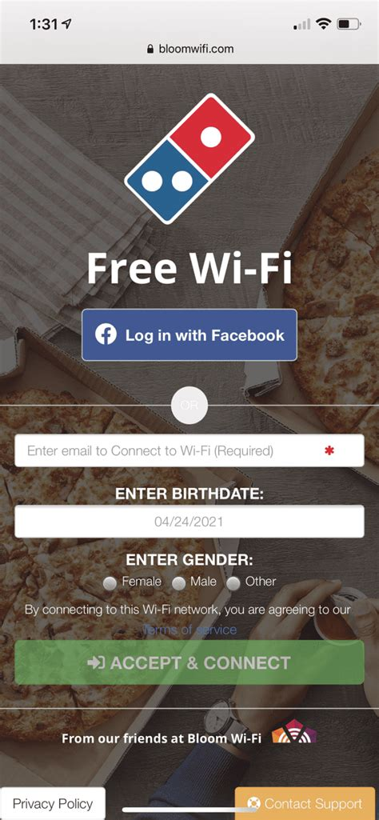
Wi-Fi Captive Portal What is a Captive Portal Wi-Fi?
https://www.linkedin.com/company/wocsa/ https://www.youtube.com/@WOCSA-rx2mn/
Public Wi-Fi in places like airports, cafes, and hotels.
Secure enterprise networks where authentication is required before granting access.
Networks that monetize internet access (e.g., by charging a fee).
https://github.com/wocsa

Slide 6
How works a Captive Portal Wi-Fi?
10/10/2024

Slide 7
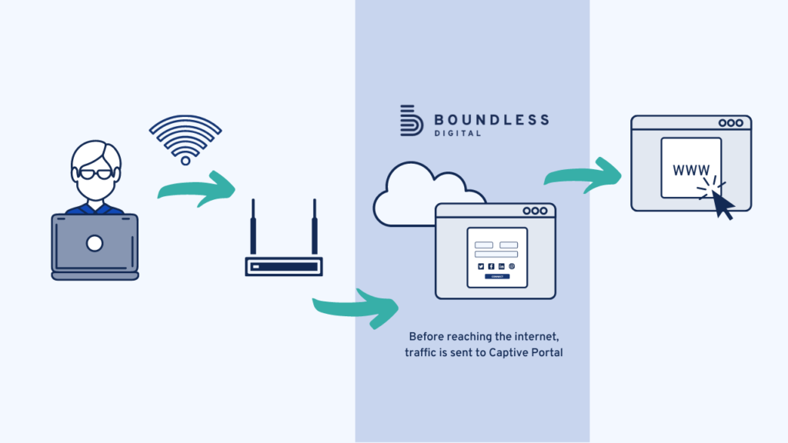
Wi-Fi Captive Portal How works a Captive Portal Wi-Fi?
https://www.linkedin.com/company/wocsa/ https://www.youtube.com/@WOCSA-rx2mn/
https://github.com/wocsa

Slide 8
What are the weaknesses of a Captive Portal?
10/10/2024

Slide 9
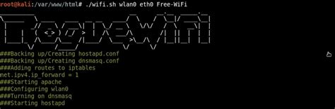
Wi-Fi Captive Portal What are the weaknesses of a Captive Portal?
https://www.linkedin.com/company/wocsa/ https://www.youtube.com/@WOCSA-rx2mn/
1. Lack of Security in Open Networks:
Most captive portals operate on open Wi-Fi networks with no encryption
2. Bypass Techniques:
Users can sometimes bypass captive portals by manually configuring their DNS settings or accessing specific IP addresses.
Tools like VPNs or proxies may allow users to bypass restrictions.
3. Vulnerabilities to Attacks:
- Captive portals can be targeted for attacks like phishing, where attackers clone the login page to steal user credentials.
- Weaknesses in portal software or configurations can expose the system to exploits, allowing unauthorized access or data theft.
4. Session Hijacking:
- Since captive portals often use IP or MAC address-based session management, an attacker may hijack a user’s session by spoofing their MAC address or IP address.
https://github.com/wocsa

Slide 10
How to protect a Captive Portal?
10/10/2024

Slide 11
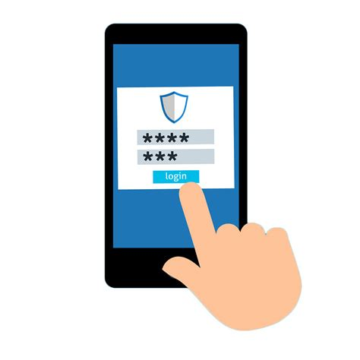
Wi-Fi Captive Portal How to protect a Captive Portal?
https://www.linkedin.com/company/wocsa/ https://www.youtube.com/@WOCSA-rx2mn/
Block all incoming connections and allow HTTPS to your router before granted user permissions
Choose carefully which public Wi-Fi you want to connect and use a VPN
https://github.com/wocsa

Slide 12







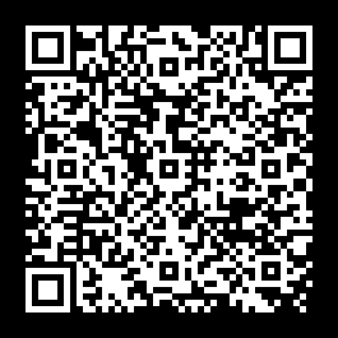


Join us to change the digital world: https://www.helloasso.com/associations/wocsa/adhesions/bulletin-d-adhesion-2 Please provide your feedback for our quality check process: https://www.wocsa.org/qcheck.php
10/10/2024
www.wocsa.org
@wocsa
@wocsa_asso
@wocsa
contact@wocsa.org
Join Us!
@WOCSA-rx2mn
https://discord.gg/pDunje3tpb

